Slide 1
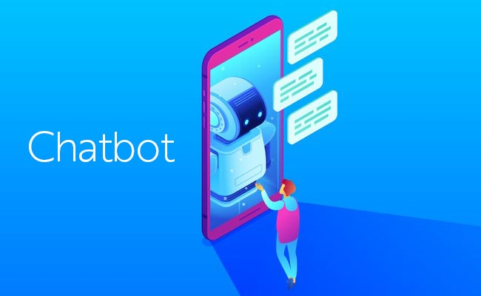

Slide 2
CHATBOT It is a computer program designed to simulate conversation with human users, especially over the internet:

Slide 3
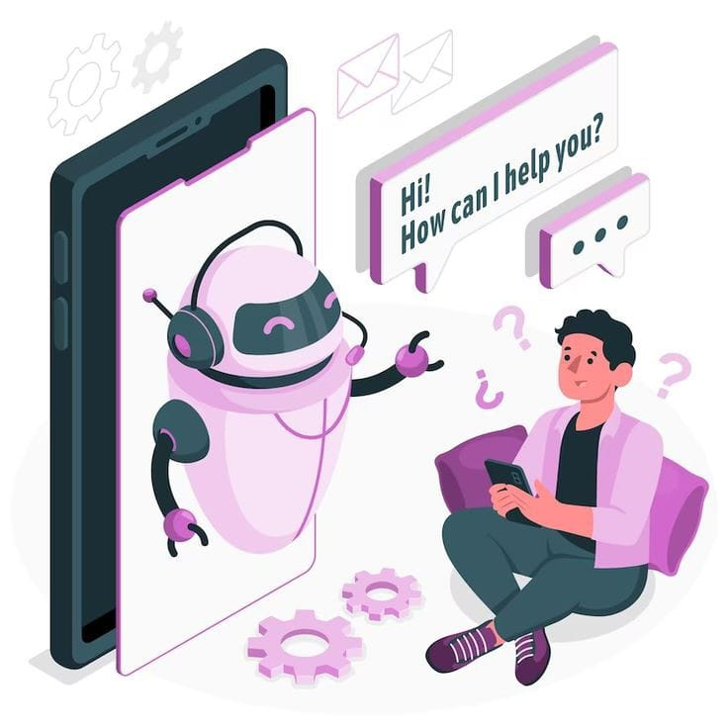
In this guide, we will walk you through the process of creating a chatbot using HTML, CSS, and JavaScript. This guide is aimed at beginners and intermediate developers and designers, who are looking to create a functional chatbot for their website or business
In this guide, we will walk you through the process of creating a chatbot using HTML, CSS, and JavaScript. This guide is aimed at beginners and intermediate developers and designers, who are looking to create a functional chatbot for their website or business

Slide 4
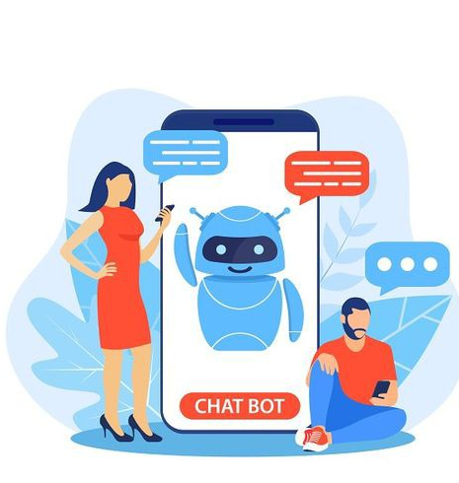
Step 1 (HTML Code):
To get started, we will first need to create a basic HTML file. In this file, we will include the main structure for our chatbot.
After creating the files just paste the following codes into your file. Make sure to save your HTML document with a .html extension, so that it can be properly viewed in a web browser.

Slide 5
Step 2 (CSS Code):
Once the basic HTML structure of the chatbot is in place, the next step is to add styling to the chatbot using CSS. CSS allows us to control the visual appearance of the website, including things like layout, color, and typography.
Next, we will create our CSS file. In this file, we will use some basic CSS rules to create our chatbot.

Slide 6
Step 3 (JavaScript Code):
Finally, we need to create a chat function in JavaScript. Below is a simple chatbot code in JavaScript that is designed to communicate with users. It consists of arrays, functions, and event listeners. The arrays "user Message" and "bot Reply" contain a list of messages that users might input and responses the chatbot might give.

Slide 7
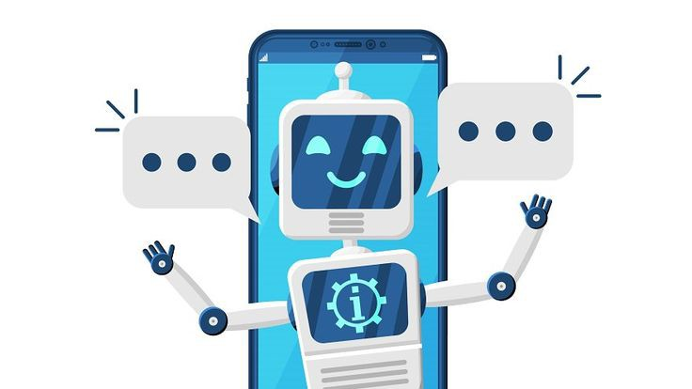
In conclusion, creating a chatbot using HTML, CSS, and JavaScript is an exciting and rewarding project that offers a lot of benefits for businesses and individuals alike. By following the steps outlined in this guide, you can create a functional and engaging chatbot that can interact with users and provide them with helpful information and support.

Slide 8
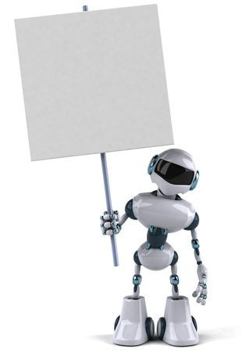
THANK YOU

